Slide 1

RSHE at Sudbourne Primary School
Parent Workshop
14.05.2026

Slide 2
Aims and content
What is RSHE?
How does RSHE link to the Science curriculum?
Objectives from Relationships and Health Education
LGBTQ+ guidance
What will be taught?
Parent access
Withdrawal process
Answering questions

Slide 3

What is RSHE?
RSHE stands for:
Relationships, Sex, and Health Education
It is sometimes referred to as RSE and Health Education
At Sudbourne, we are required to teach RSHE in line with the DfE guidance (2020)

Slide 4

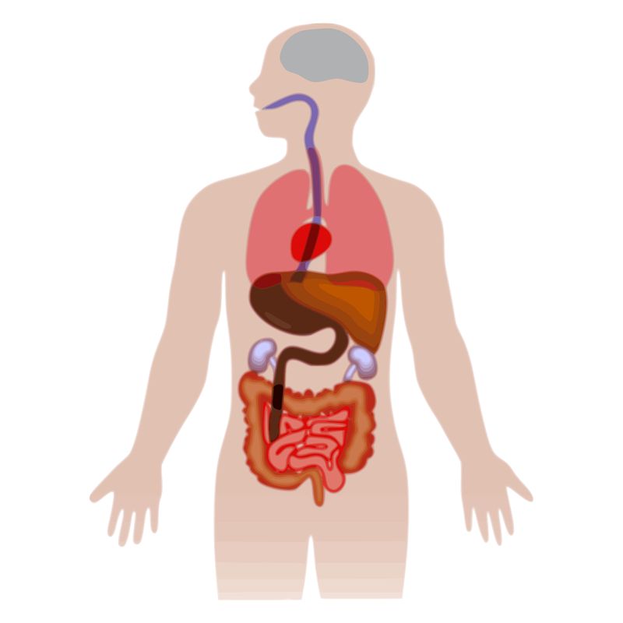


What is statutory?
Science
Education
Relationships
Education
Health Education
(including puberty)
Sex Education
Statutory
Statutory
Statutory
Discretionary

Slide 5
Is there any Sex Education within the compulsory Science curriculum?

Slide 6
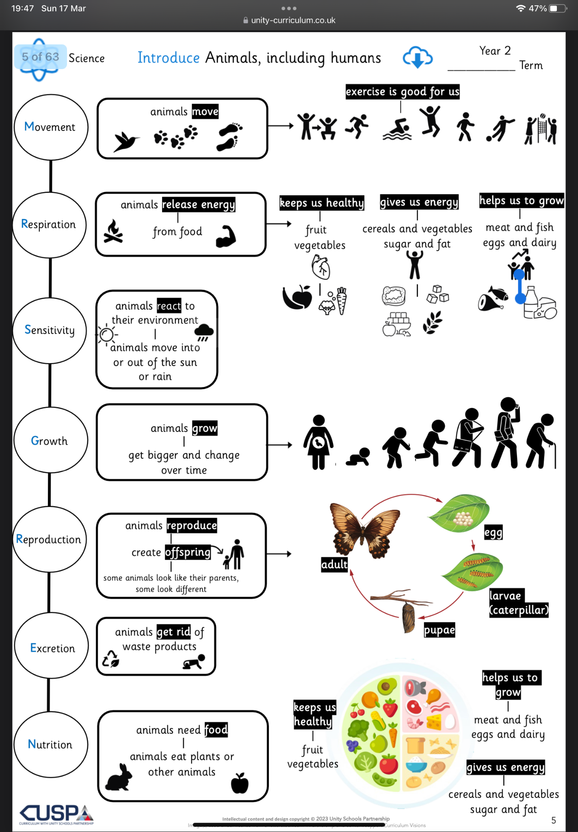
Science - Phase 1
Animals including humans
knowing and locating the main body parts of a human, focusing on the five senses
knowing and explaining that animals, including humans, have offspring which grow into adults
knowing and explaining simple life cycles of animals, including humans

Slide 7
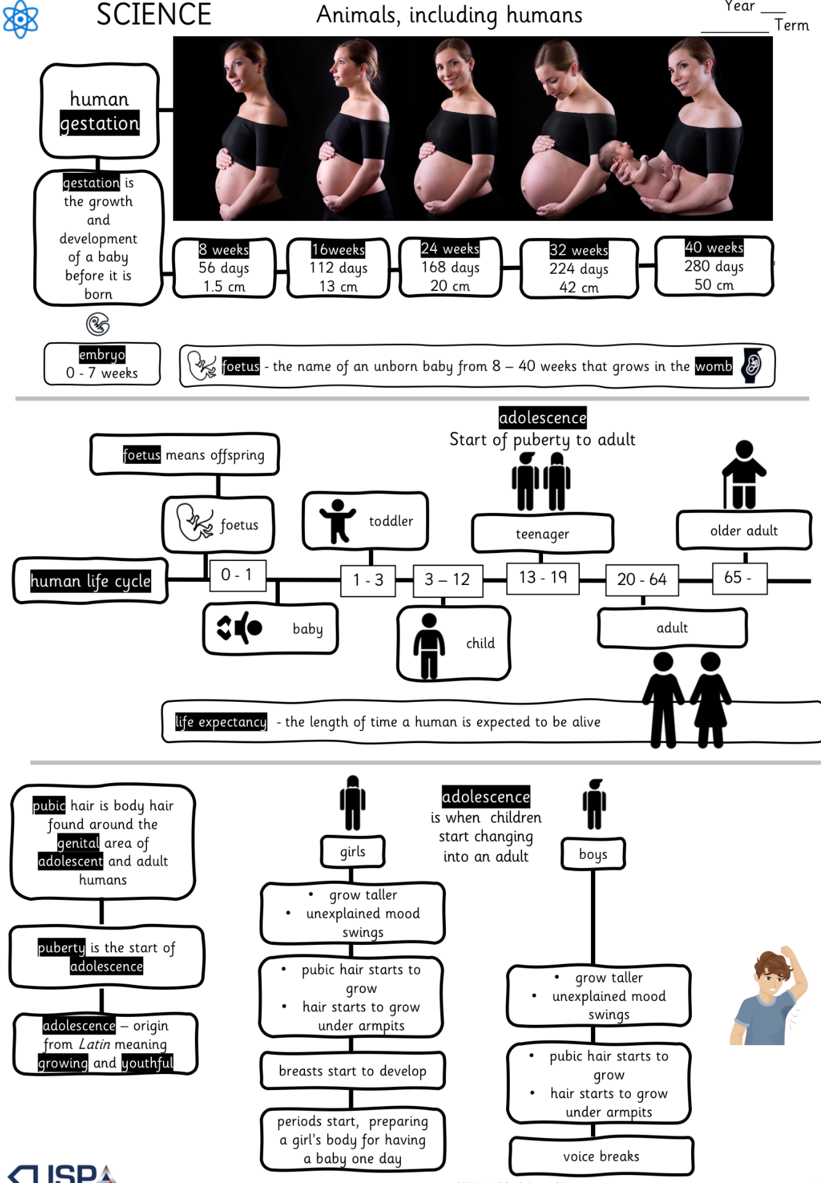
Science - Phase 3
Animals including humans
explaining the changes humans go through to old age
using a timeline to show stages of growth and development of humans, including puberty
explaining the difference in gestation periods of humans to other animals, such as an elephant or butterfly

Slide 8
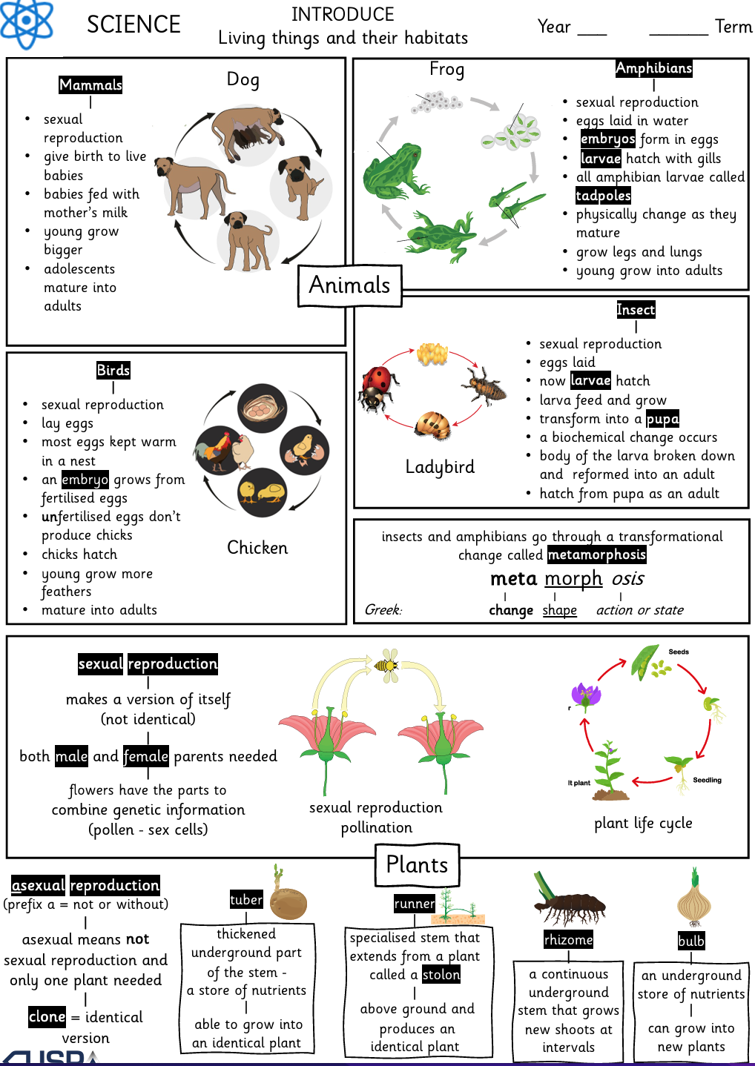
Science - Phase 3
Living things and their habitats
explaining the differences in the life cycles of a mammal (dog), an amphibian (frog), an insect (ladybird) and a bird (chicken)
explaining the life process of sexual and asexual reproduction in some plants and animals - mentions fertilisation on a cellular level but not sexual intercourse

Slide 9

What is taught in RSHE?

Slide 10
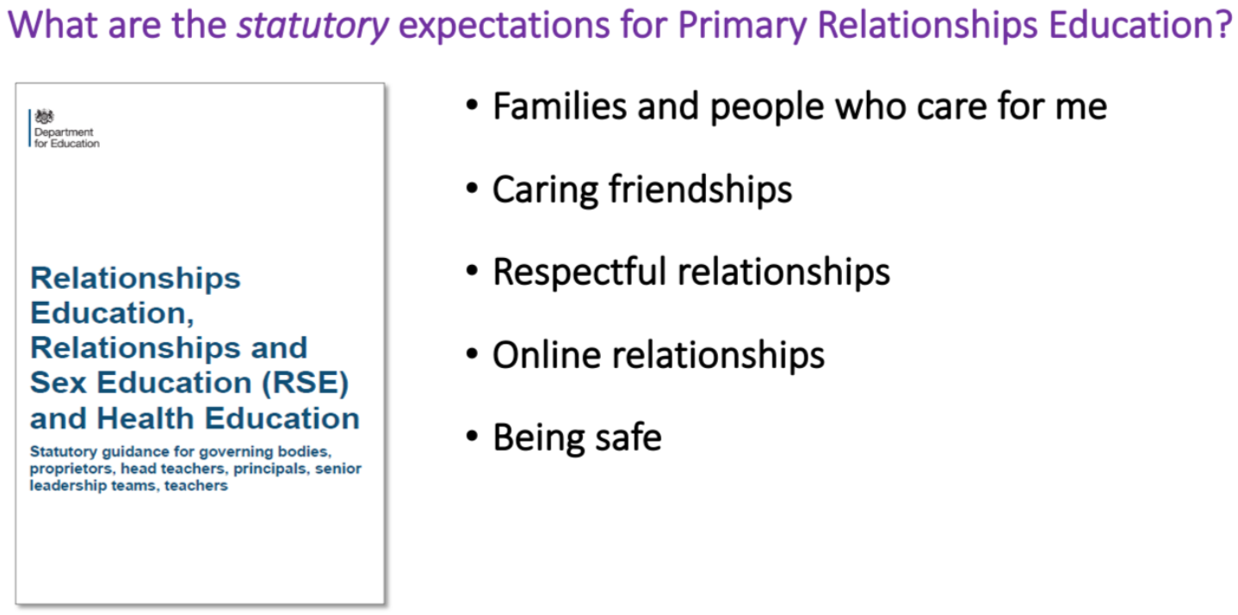
Relationships Education (statutory)

Slide 11
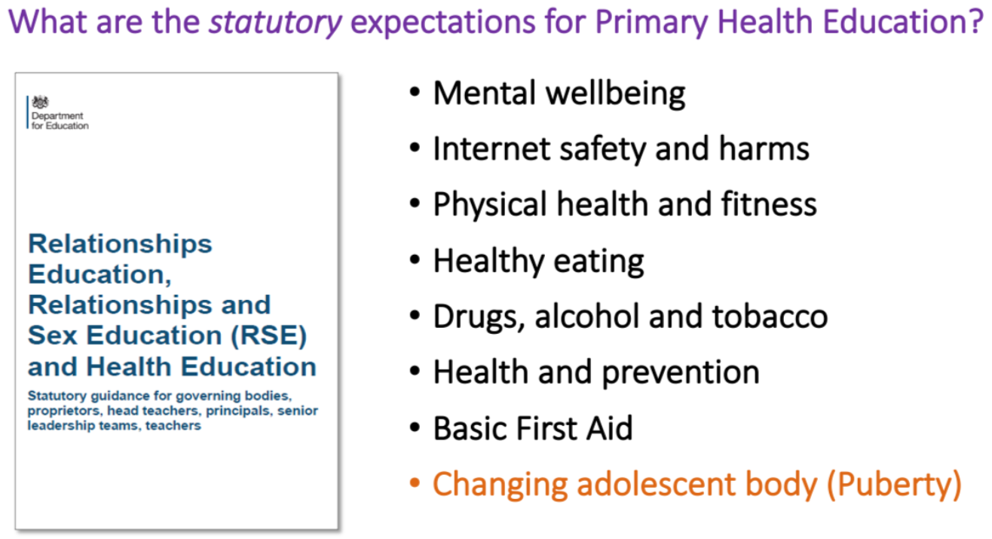
Health Education (statutory)

Slide 12
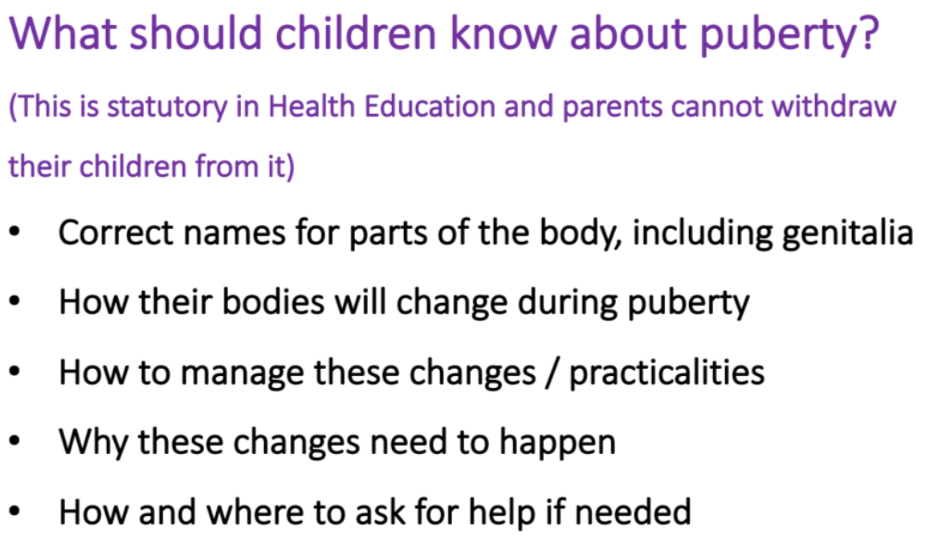
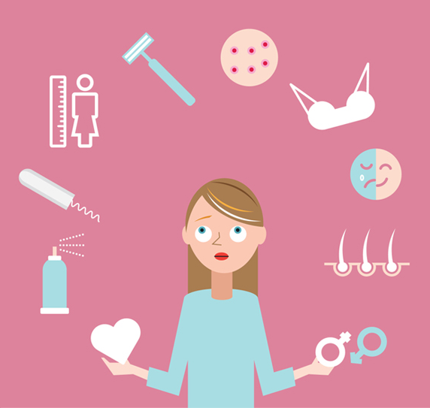
Health Education (statutory)

Slide 13
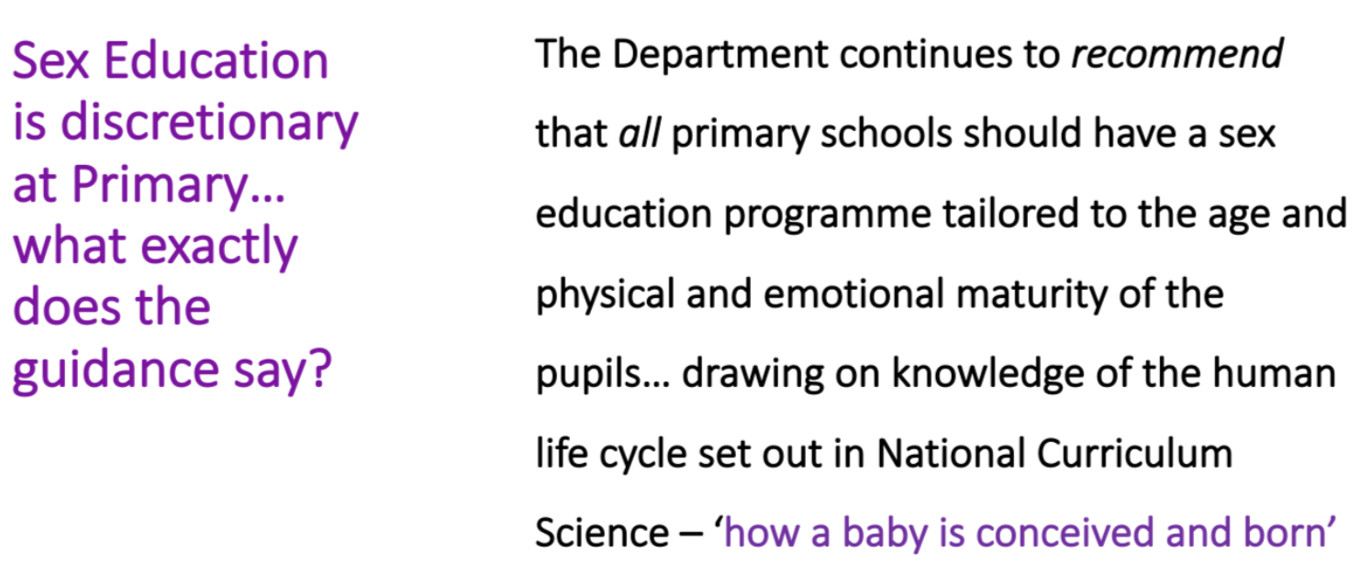
Sex Education (discretionary)

Slide 14
LGBTQ+ - The Department for Education’s Guidance
Schools must ensure that they comply with the relevant provisions of the Equality Act 2010 under which sexual orientation and gender reassignment are amongst the protected characteristics. The Equality Act encourages schools to meet the diverse needs of children and to improve outcomes for all pupils regardless of background. Part of the Equality ‘duty’ is to teach children about rights and responsibilities, acceptance, empathy and understanding of others.
All pupils should be taught LGBTQ+ content at a timely point as part of this area of the curriculum, and this content should be fully integrated into the curriculum rather than delivered as a standalone unit or lesson.

Slide 15
LGBTQ+ - Sudbourne’s Approach
Sudbourne’s key message: Kindness and respect for all, irrespective of their age, gender, race, faith, ability, family composition, sexual identity, or sexual orientation.
Through our Jigsaw curriculum, we teach children to be kind, understanding and respectful of others even if they are perceived as different.
We teach children that people have rights but there are also responsibilities that go with these.
We teach children that there are laws to protect them and others from being hurt or abused and help protect them from bullying, such as the Equality Act 2010.
We also help to clarify (age-appropriately) questions that children may have about the world.

Slide 16

LGBTQ+ - What we don’t do
We do not teach or encourage children to be LGBTQ+.
Our lessons focus on reproduction. We do not teach about what individuals (including LGBTQ+ people) do sexually or how their relationships function.
By answering children’s questions age-appropriately, we do not sexualise children, destroy their innocence, or encourage them to experiment. There is a wealth of well- researched peer-reviewed evidence that supports this.
We do not undermine ‘family values’.

Slide 17
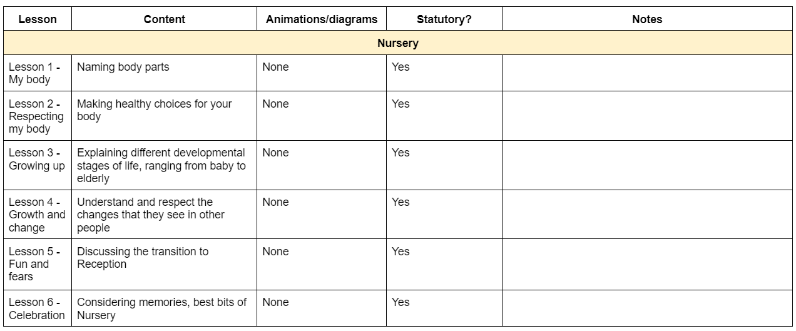
Nursery

Slide 18
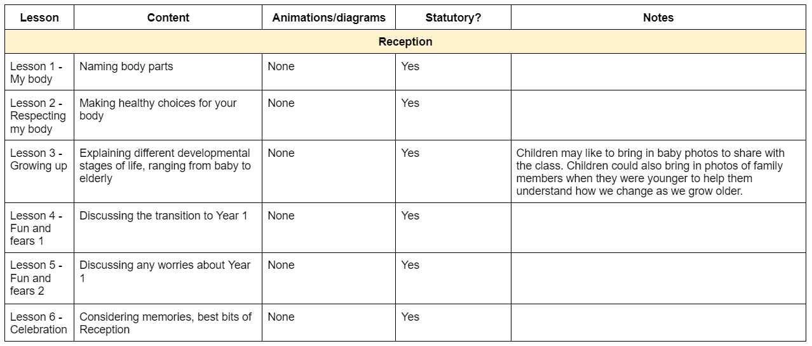
Reception

Slide 19
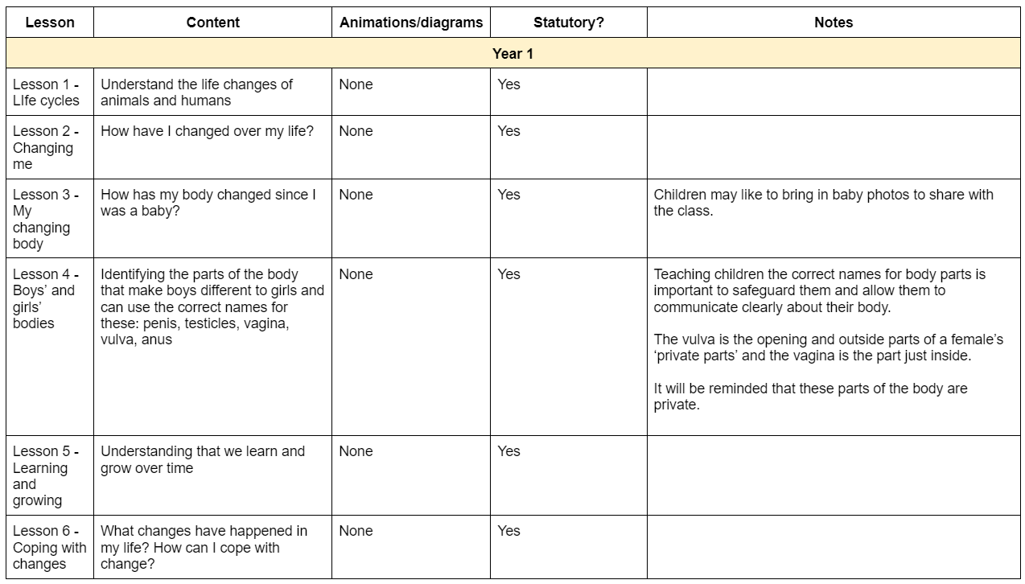
Year 1
These lessons will be taught in year group.

Slide 20
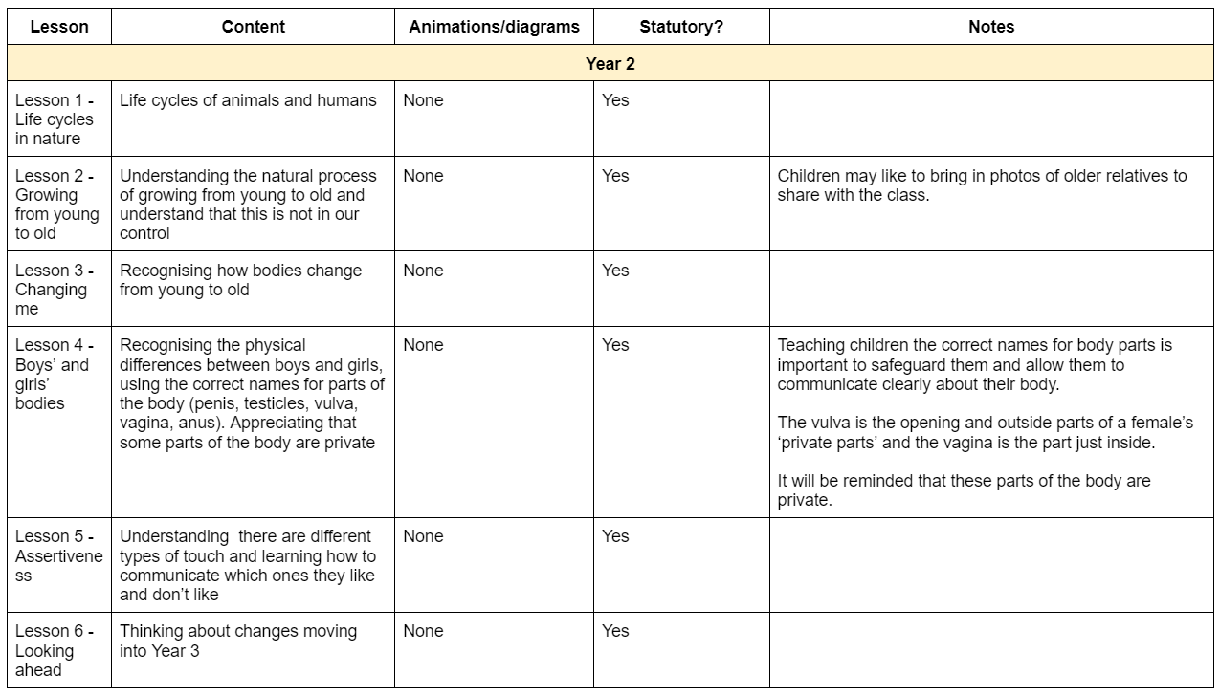
Year 2
These lessons will be taught in year group.

Slide 21
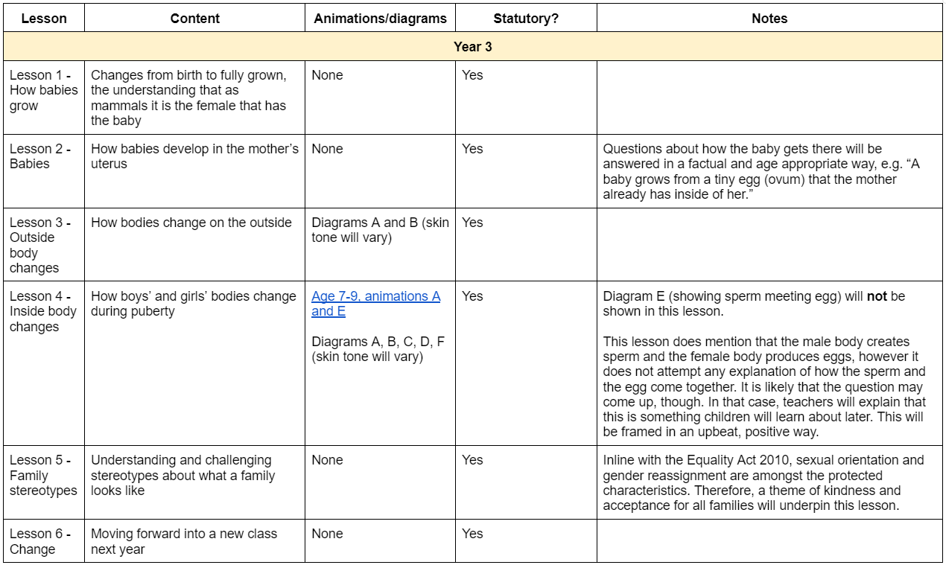
Year 3
These lessons will be taught in year group.

Slide 22
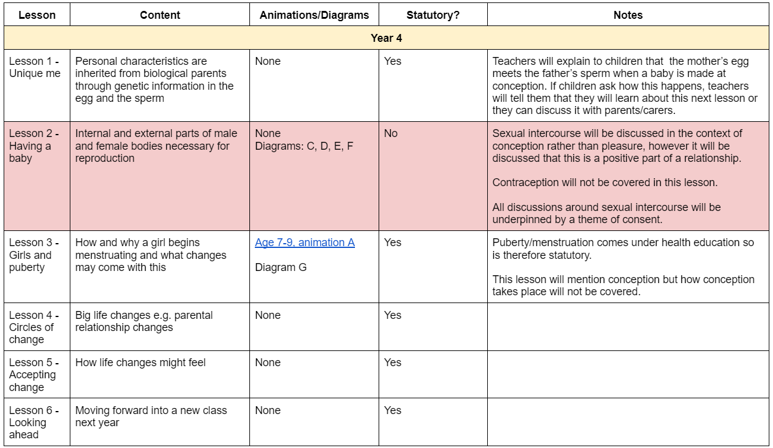
Year 4
These lessons will be taught in year group.

Slide 23
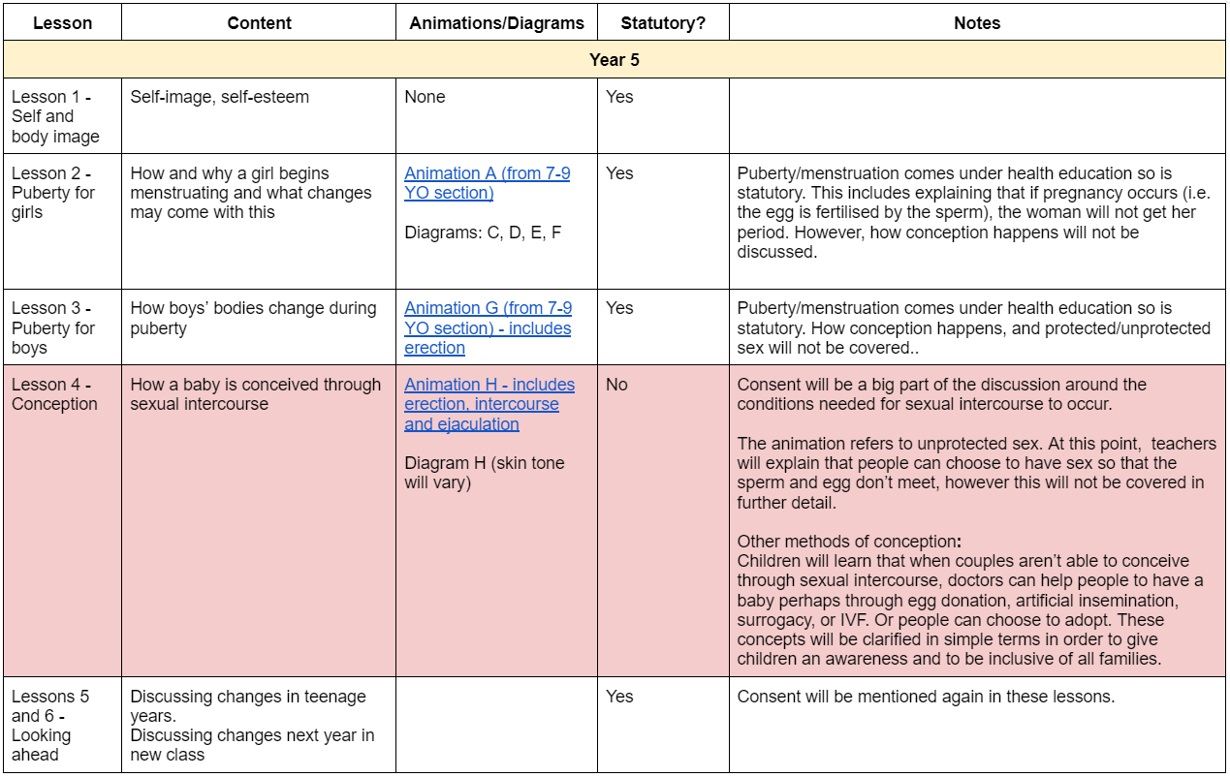
Year 5
These lessons will be taught in year group.

Slide 24
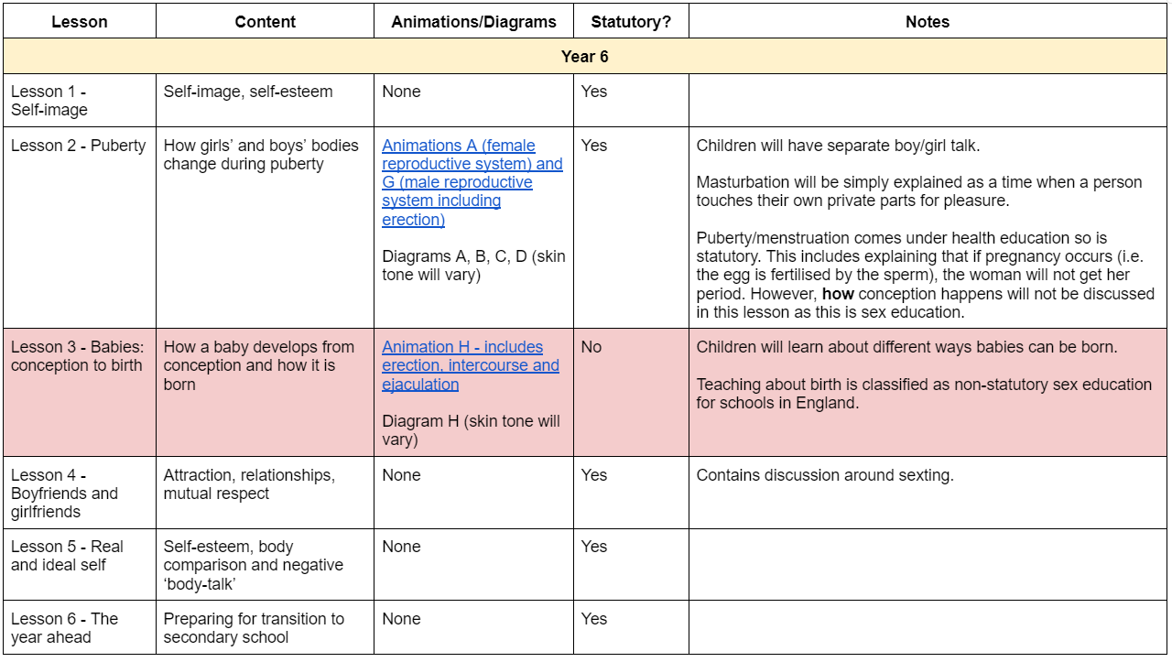
Year 6
These lessons will be taught in year group.

Slide 25
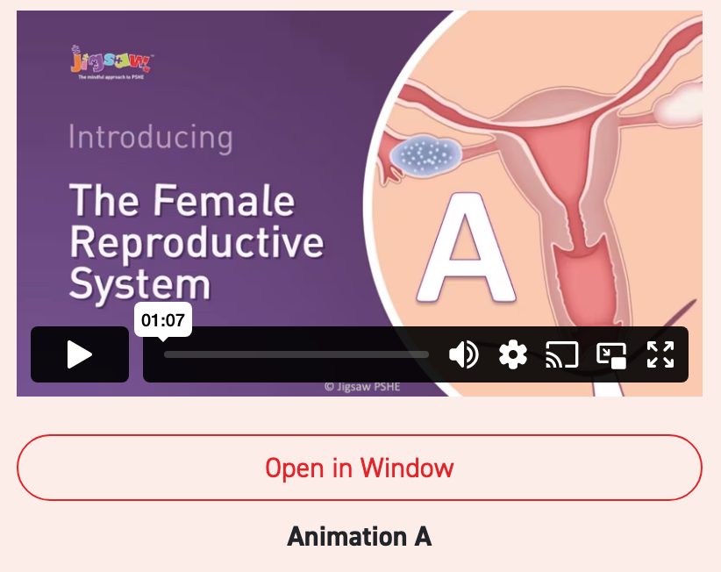
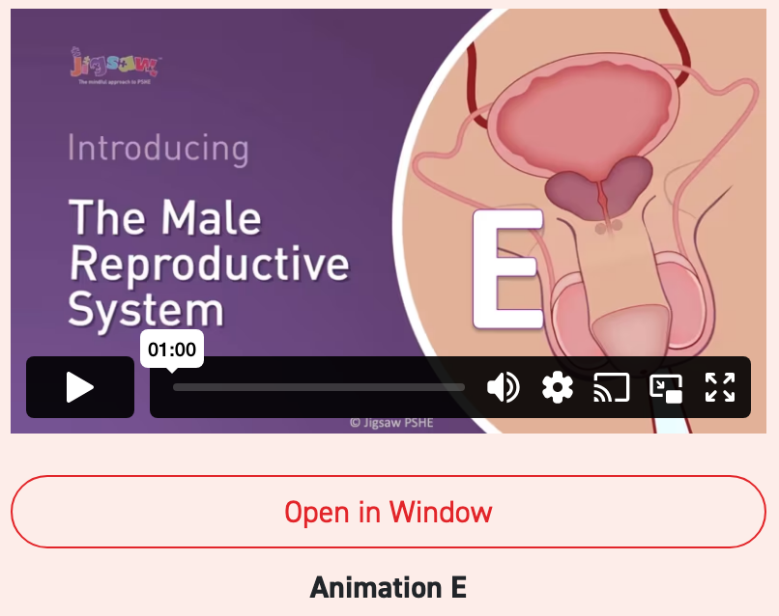
Animations
Shown in Year 3, 4 and 5 (statutory health education)

Slide 26
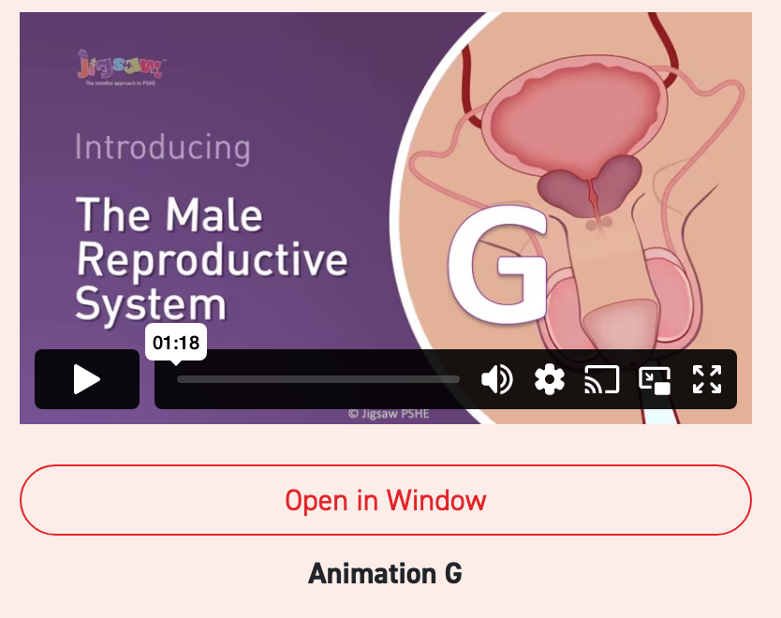
Animations
Shown in Year 5 and 6 (statutory health education)
Includes erection and ejaculation

Slide 27
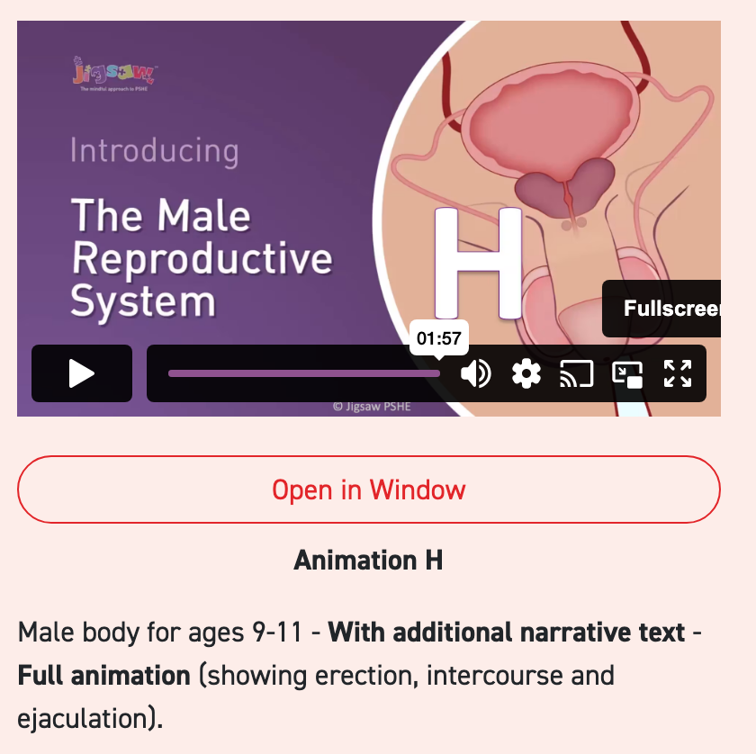
Animations
Shown in Year 5 and 6 (discretionary sex education)
Includes erection, intercourse and ejaculation

Slide 28
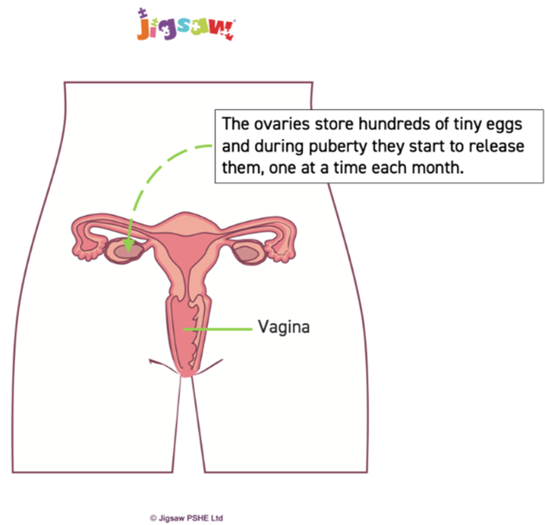
Diagrams
Our teaching is supported by carefully chosen, age-appropriate diagrams from Jigsaw, included where we feel it is beneficial to the children’s understanding.
Please see the handout for each diagram and when it will be shown.

Slide 29

Parents/Carers and RSHE

Slide 30

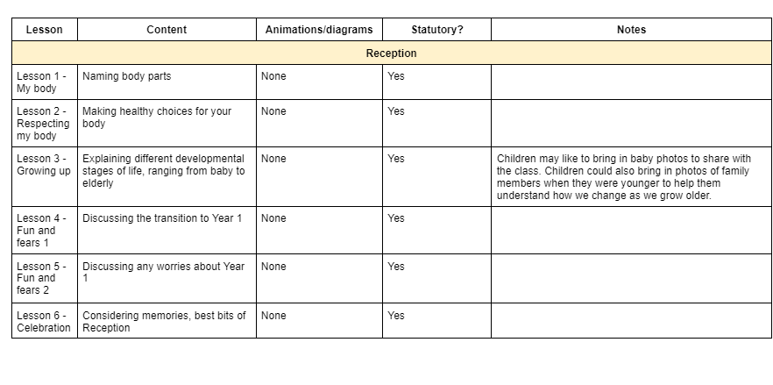
Parent access to materials and plans
Contact the office for access to the
Jigsaw materials.
admin@sudbourne.com
Our parental guidance document explains how lessons have been adapted from the Jigsaw content inline with our RHSE policy.

Slide 31
Discretionary Lessons
In today’s internet culture, children and young people are increasingly exposed to content surrounding sex and relationships. Therefore, we consider it important for them to be taught about these topics in an age-appropriate way within a safe environment in order to educate them, empower them and safeguard them.
We encourage you to closely read the guidance to enable you to make an informed decision regarding whether you child takes part in the discretionary lessons.
We would welcome further conversations about this if you would like.

Slide 32
Withdrawing children from Sex Education
Parent/carer reviews content and chooses to withdraw
Parent/carer writes to Ms Kingshott and Ms Gregory to withdraw
Ms Kingshott and Ms Gregory meet with parent/carer
Ms Gregory creates register of children who are being withdrawn from Sex Education this academic year

Slide 33
How can I support my child?
Familiarise yourself with the content and consider what questions your child may have.
Have conversations beforehand if you feel it would be beneficial for your child.
Be open and positive in conversations. Follow their lead.
Consider buying a book to read together and support discussions in an age-appropriate way.

Slide 34

Questions

